Slide 1
Continuous Measurement and Feedback Control of a Quantum Harmonic Oscillator
Slide 1(15)
By Max Eriksson
Supervised by Peter Samuelsson and Kalle Kansanen

Slide 2
Introduction
Slide 2(15)
Technologies
Cooling
Outline

Slide 3
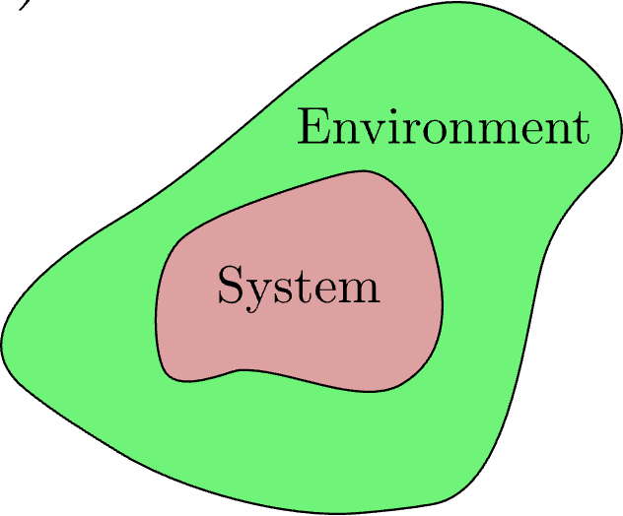
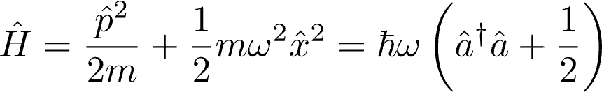
Introduction Quantum Harmonic Oscillator
Slide 3(15)
Schematic View
Hamiltonian
Physical Realizations

Slide 4
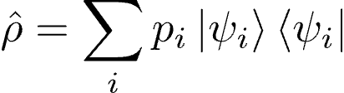
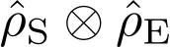
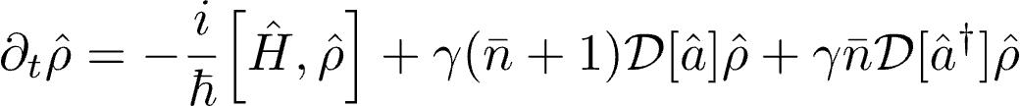
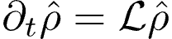
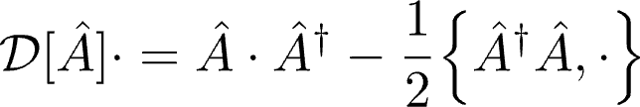
Theoretical Framework Open Quantum Systems
Slide 4(15)
Density Matrix
Born-Markov Approximation
Master Equation
Notes:
Unit trace, ii) positive semi-defiinite
Born: Negligible excitations
Markov: excitations decay faster than the timescale the system varies. Only dependent on the current state.

Slide 5
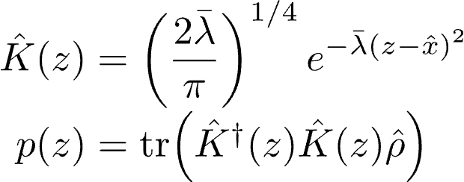
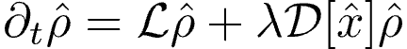
Theoretical Framework Continuous Measurements
Slide 5(15)
Decoherence and POVM
Measurement Operator
Master Equation
Notes:
POVM = Positive Operator Valued Measure

Slide 6
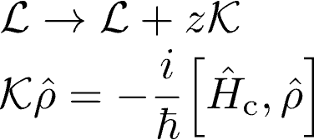
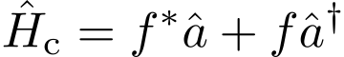
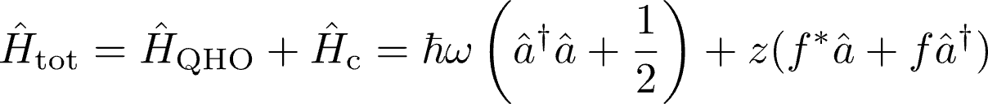
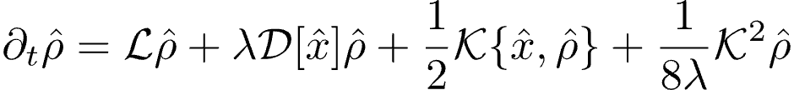
Theoretical Framework Feedback Control
Slide 6(15)
Linear Feedback
Control Hamiltonian
Total Hamiltonian
Wiseman-Milburn Equation

Slide 7
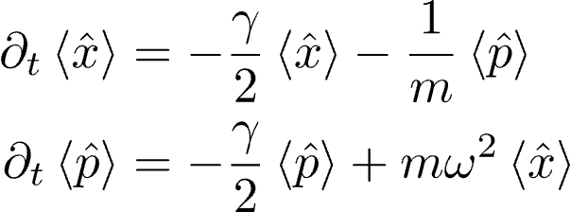
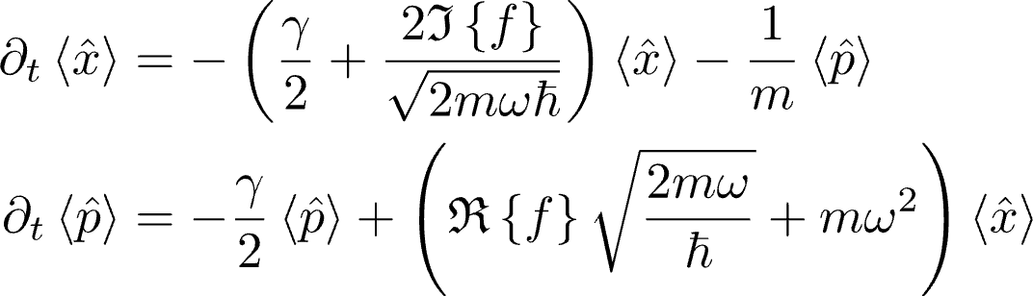
Results Equations of Motion, First Moments
Slide 7(15)
Measurement
Measurement + Feedback

Slide 8
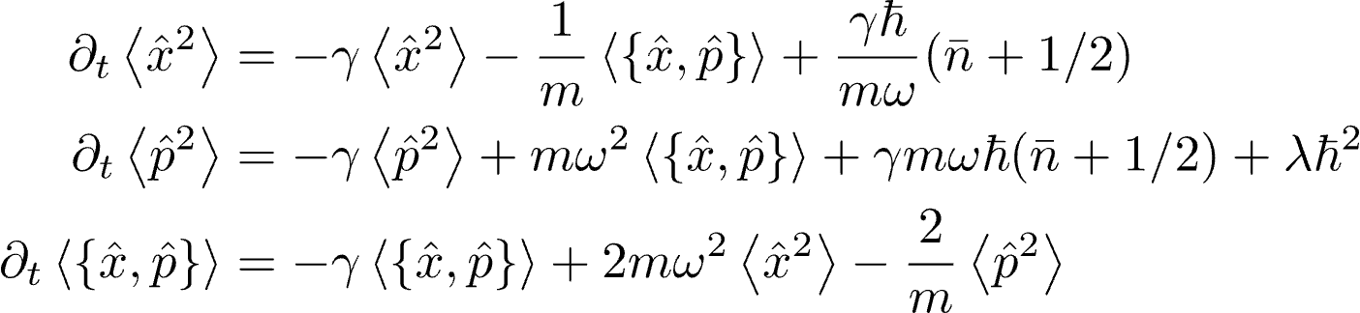
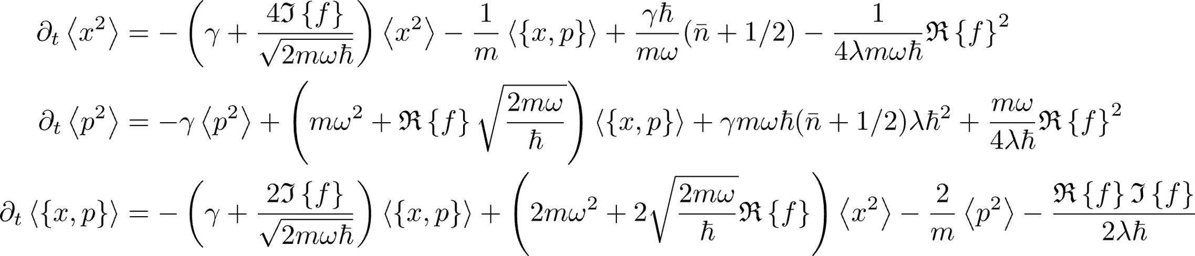
Results Equations of Motion, Second Moments
Slide 8(15)
Measurement
Measurement + Feedback

Slide 9
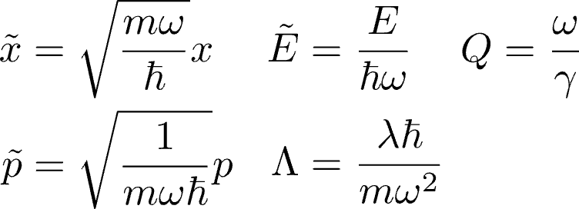
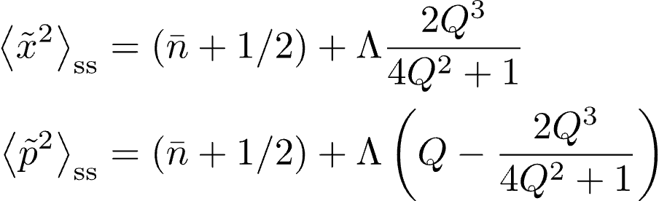
Results Steady States, Second Moments
Slide 9(15)
Dimensionless Quantities
Measurement
Measurement + Feedback
Doesn’t fit

Slide 10
Results Energy and Feedback
Slide 10(15)
Phase and Magnitude
Blue and Red Regions

Slide 11
Results Energy and Feedback
Slide 11(15)
Energy
Cooling

Slide 12
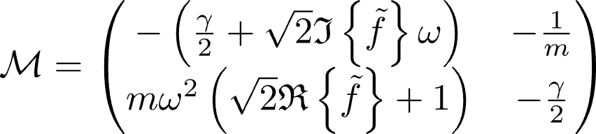
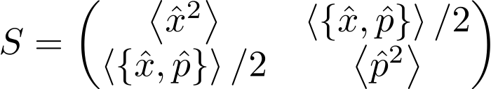
Results Stability
Slide 12(15)
Eigenvalue Analysis
Lyapunov Equation

Slide 13
Discussion Cooling of Quantum Harmonic Oscillator
Slide 13(15)
Cooling Possible, and Stable
Feedback Parameter
Quality Factor Impact
Infinite Bandwidth

Slide 14
Outlook
Slide 14(15)
Promising Cooling
Other Feedback Schemes
State Preparation
Stabilizing

Slide 15
Thank you for listening
Slide 15(15)
Questions?

